Slide 1
Spam Detection
A Machine Learning Approach to Classify Text Messages

Slide 2
Project Objective:
Develop a model to classify text messages as spam or ham. Implement the Multinomial Naive Bayes algorithm. Utilize various Python libraries for data analysis and visualization.

Slide 3
Table of contents
Project Objective
Tools and Libraries Used
Dataset Overview
Data Cleaning and Preprocessing
Exploratory Data Analysis (EDA)
Text Vectorization
Model Training and Evaluation
Conclusion
References

Slide 4
Tools and Libraries used:
pandas for data manipulation numpy for numerical operations matplotlib and seaborn for data visualization scikit-learn for machine learning models
Google Colab Notebook

Slide 5
Dataset Overview:
CSV file named spam.csv containing labeled text messages.
Columns include 'v1' (ham/spam) and 'v2’.
Dataset is cleaned and prepared for model training.

Slide 6
Data Cleaning and Preprocessing:
Remove unnecessary columns and rename for clarity.
Handle missing data and remove duplicates.
Rename the columns and check for null values.
Text cleaning (eg. lowercasing , removing special characters)

Slide 7
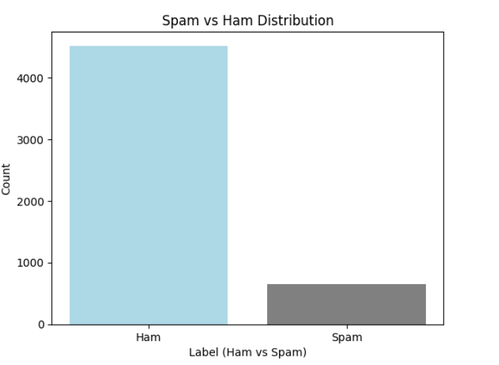
Exploratory Data Analysis (EDA)
Analyze the distribution of spam vs. ham messages

Slide 8
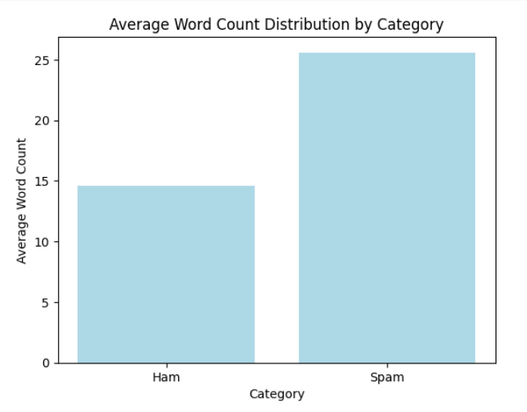
Exploratory Data Analysis (EDA)
Visualize average word count by category using bar plots.

Slide 9
Text Vectorization
Convert messages to lowercase and remove special characters.
Standardize text data for better model training.
Transform text data into numerical format using TF-IDF.
Limit to the 5000 most important words for model training.

Slide 10
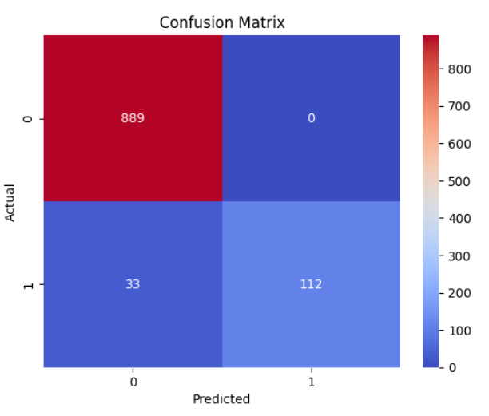
Model Training and Evaluation
Split data into training and testing sets. Train the model using the Multinomial Naive Bayes. Evaluate model accuracy and visualize results with a confusion matrix.

Slide 11
Conclusion
The spam detection model was effectively trained and tested. Multinomial Naive Bayes showed promising results, and further enhancements could lead to better performance.

Slide 12
References
Dataset source: spam.csv.
Python libraries documentation: pandas, numpy, matplotlib, seaborn, scikit-learn.
Notebook Interface: Google Colab.

Slide 13
Thank you!

